Slide 1
LOAN MANAGEMENT
Loan Issue , Installment and much more

Slide 2
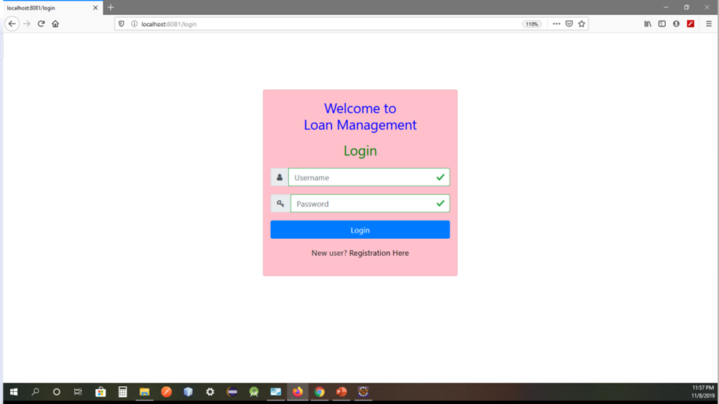
We can both log in as admin or user
New User can register as an user

Slide 3
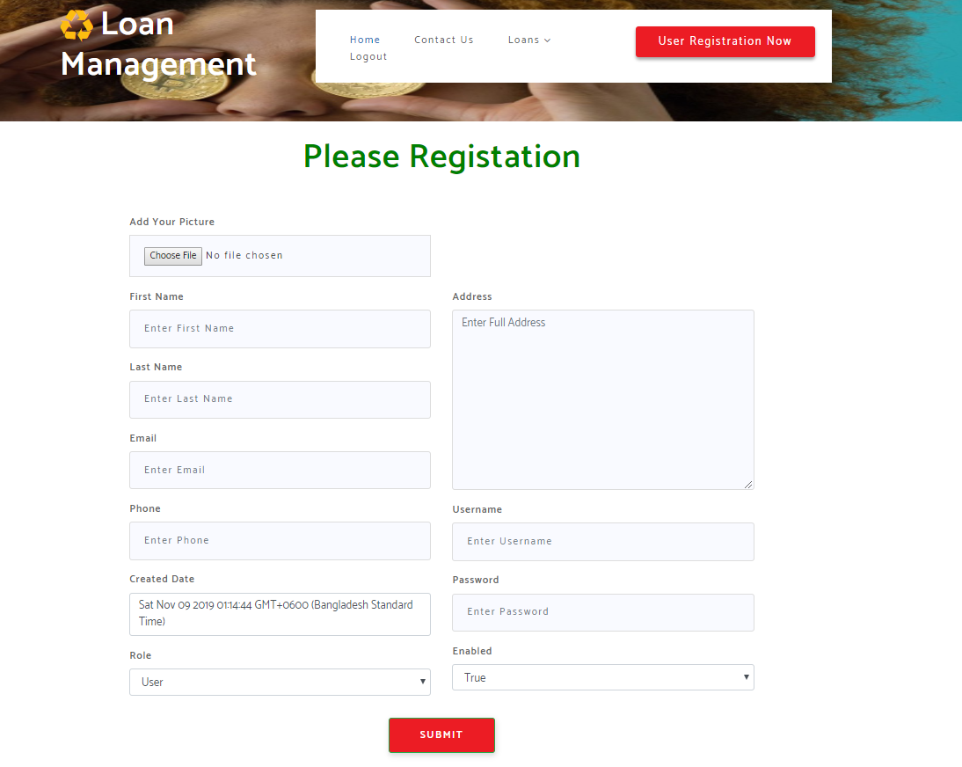
User can register here >Attaching his picture from his device
Password will be encrypted

Slide 4
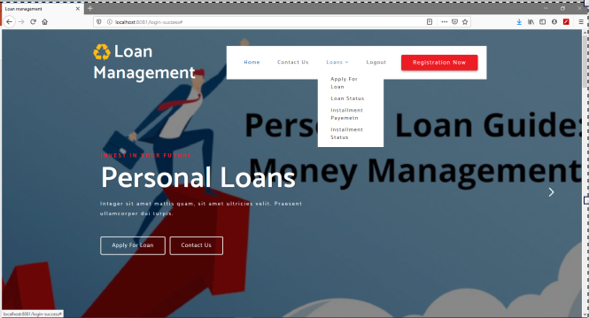
Multiple tasks are provided here >Register as an user >Apply Loan
>Contact Us >Check Loan Status
>Installment Pay >Installment Status

Slide 5
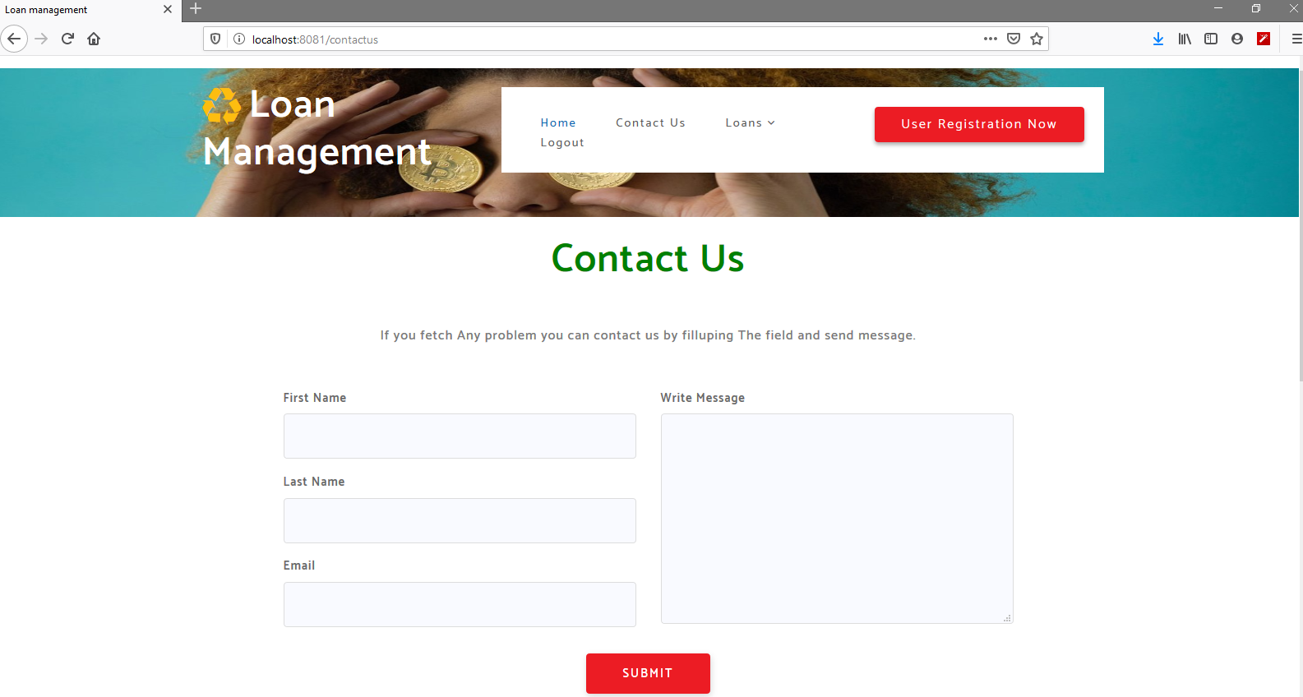
User can contact with authority submitting their feedback

Slide 6
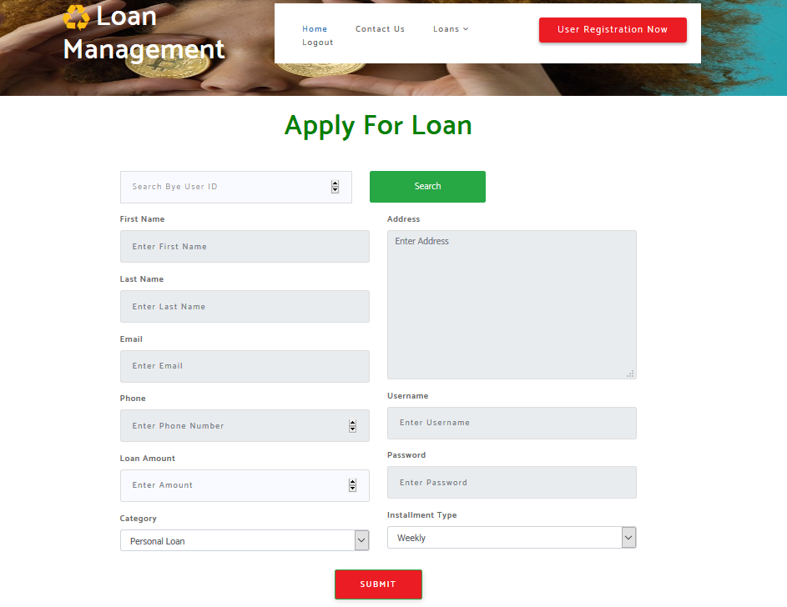
Apply Loan for various perspective such as >Personal Loan >Business Loan >Home Loan >Education Loan >Car Loan

Slide 7
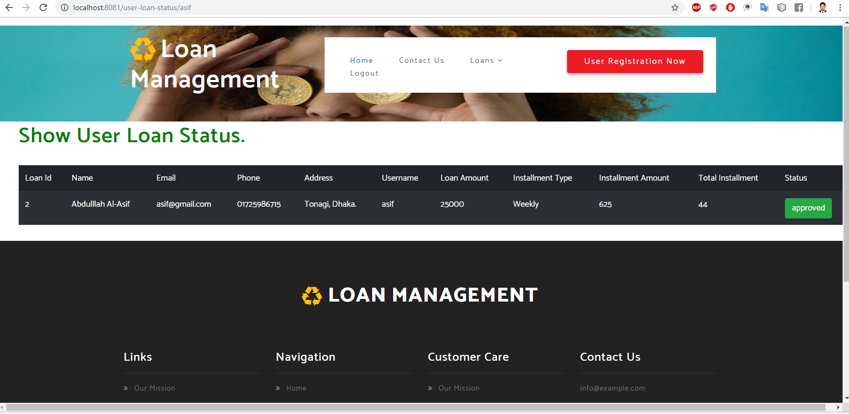
Loan status of the user who is logged in currently

Slide 8
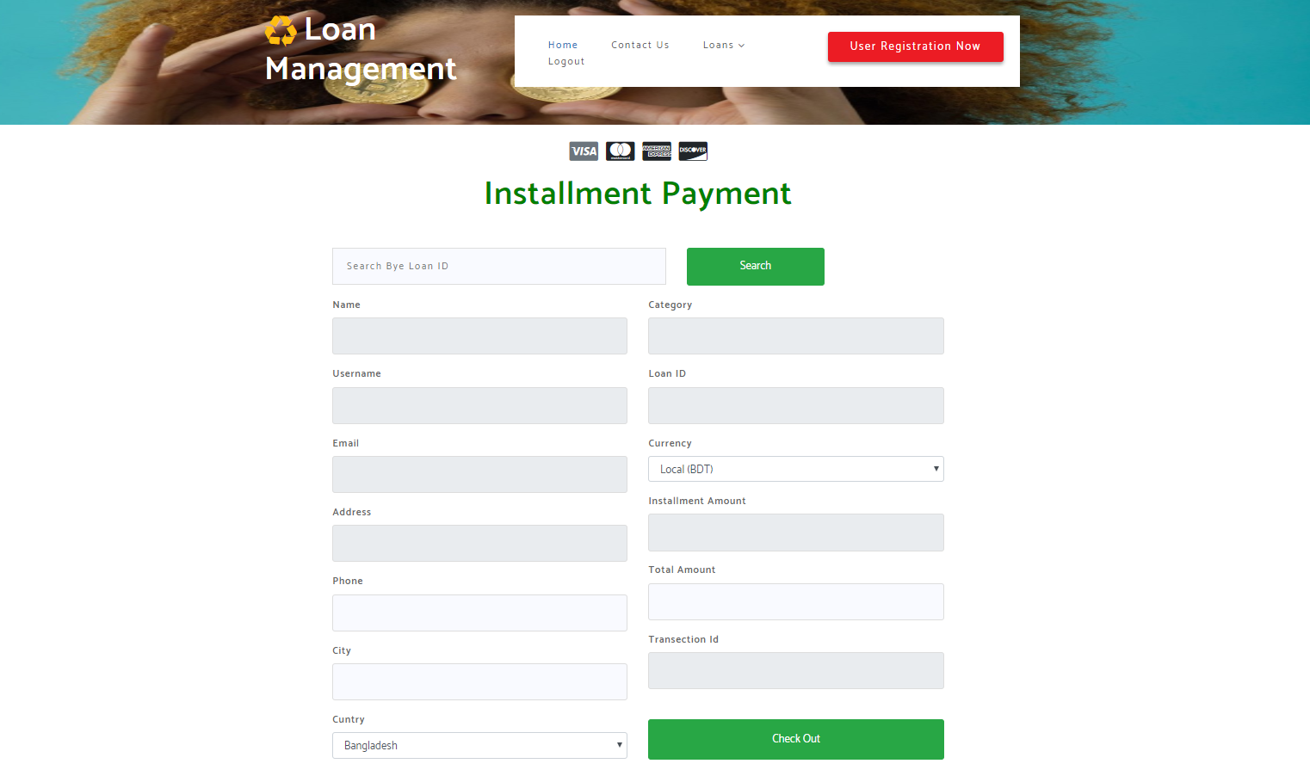
Online Installment payment

Slide 9
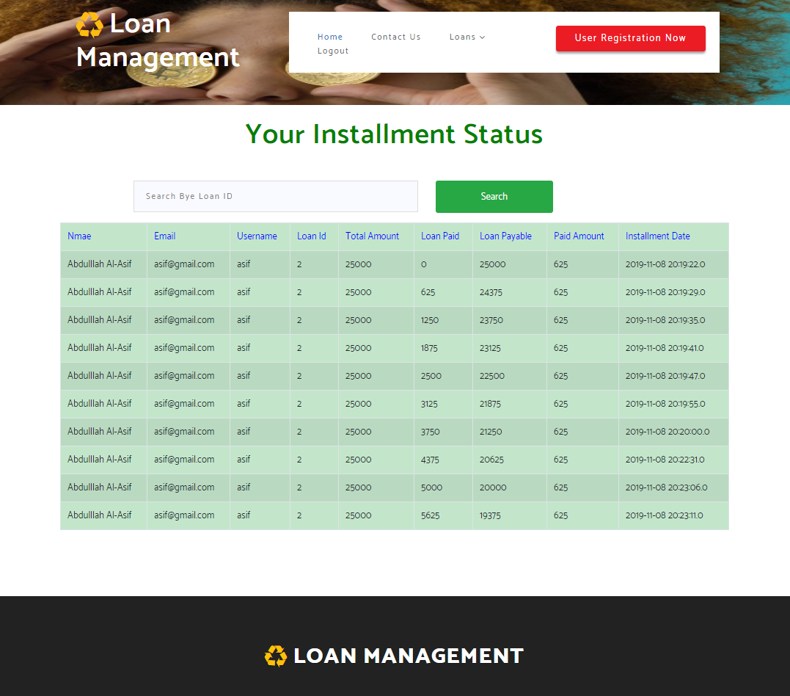
Check Installment Status

Slide 10
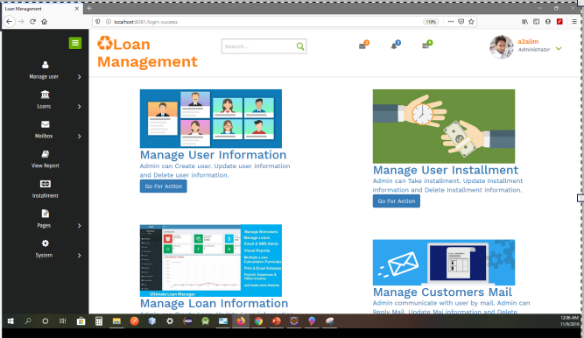
Admin Home Page

Slide 11
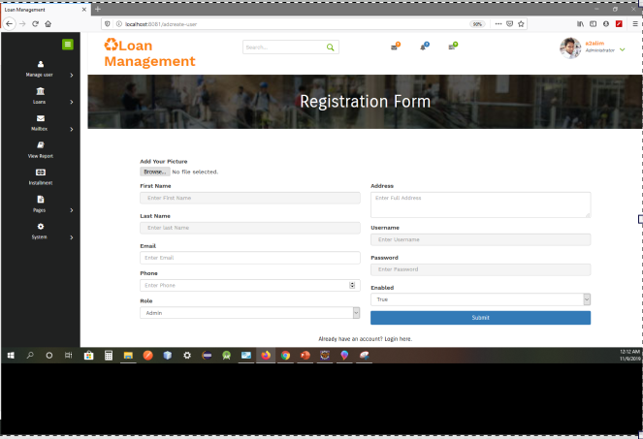
Admin can register user, manager or assign new admin
User Registration Page
Password will be encrypted
Attaching user’s picture from his device

Slide 12
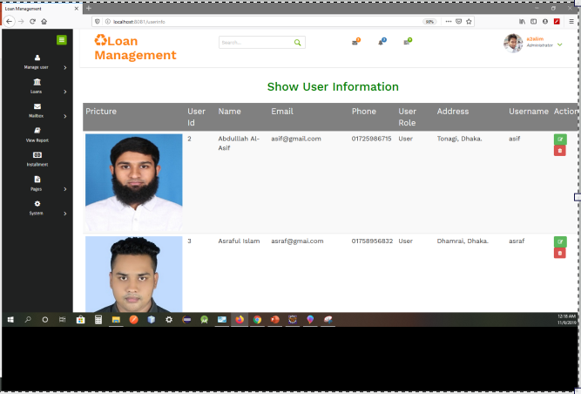
User Details
Admin can update their information
Delete unnecessary user

Slide 13
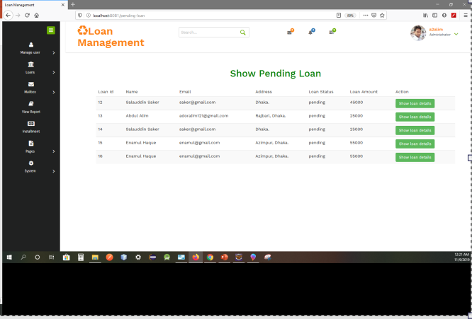
Applied Loans Display here
Admin can show details of the applied loan

Slide 14
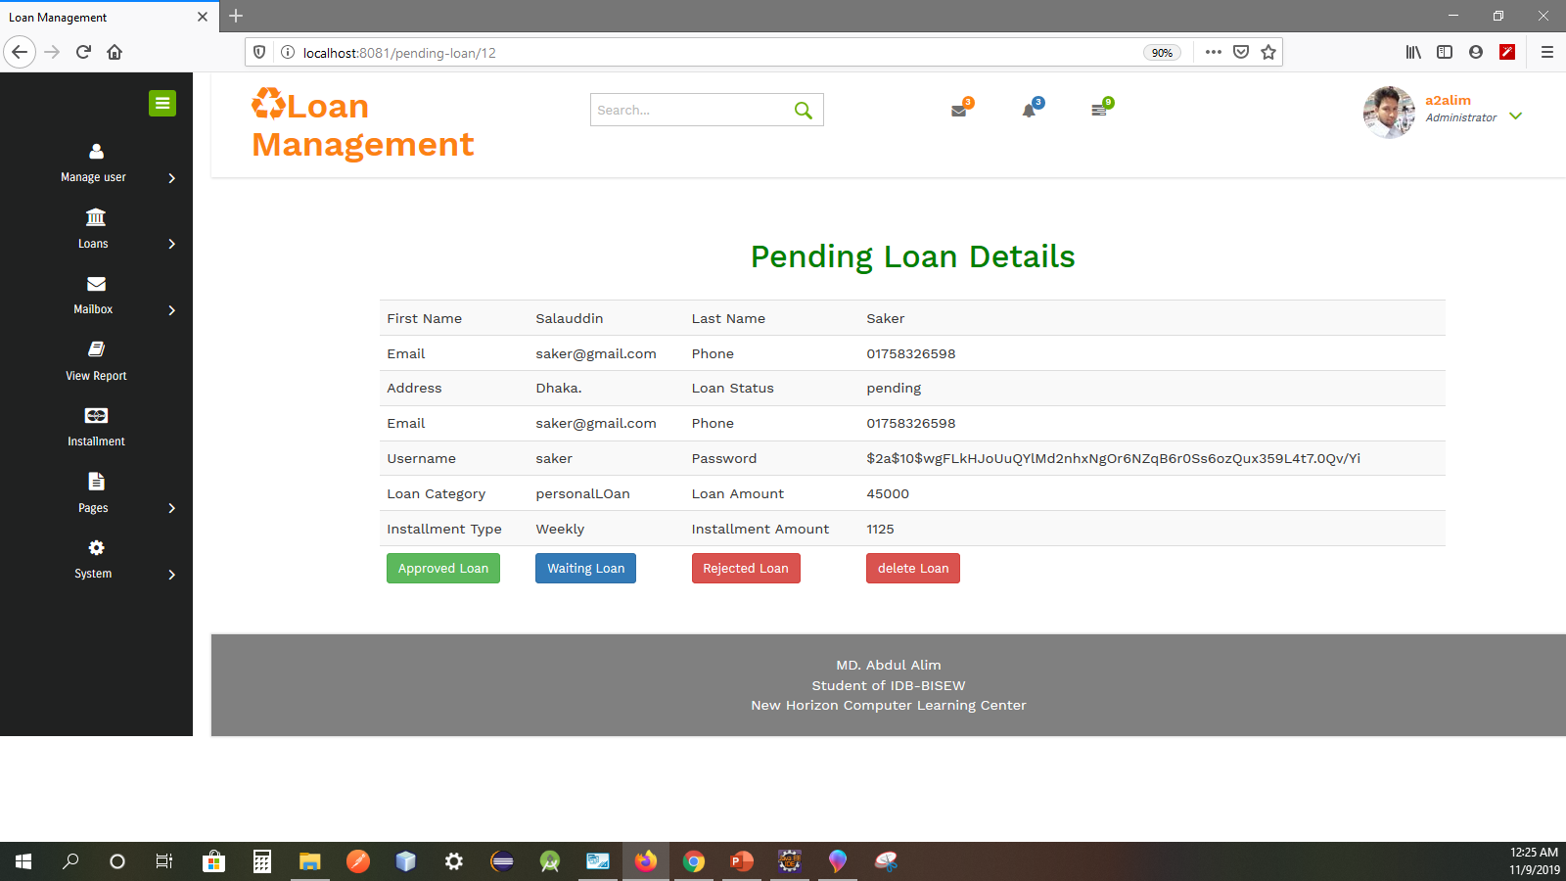
Admin can either approve a particular loan
Or send it to waiting loan
Directly reject it
Delete the invalid loan

Slide 15
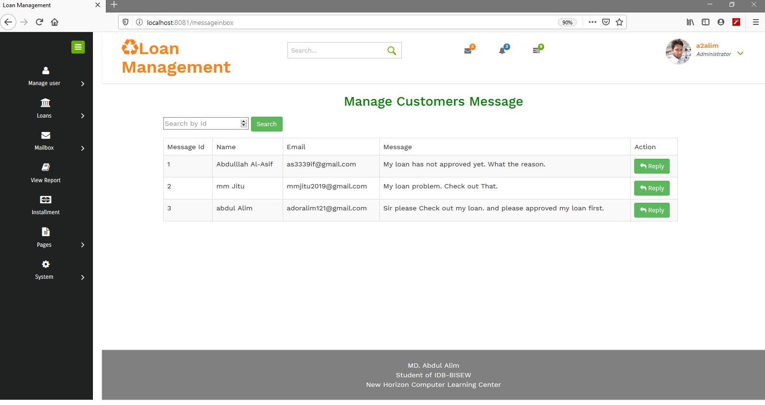
Manage Users Feedback
Reply by clicking on the reply icon
Search by message id to reply a particular user

Slide 16
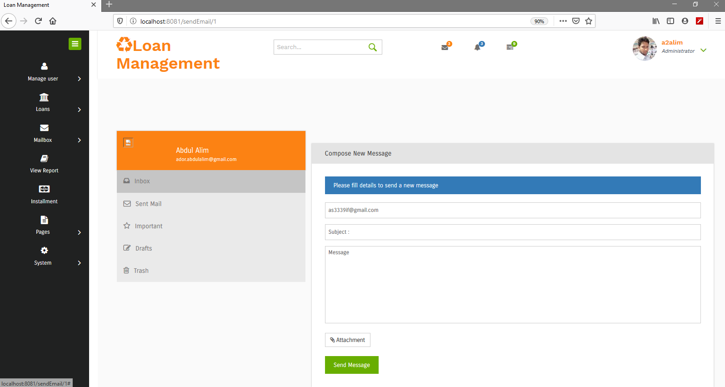
Reply to a User’s feedback by sending email to his valid email address

Slide 17
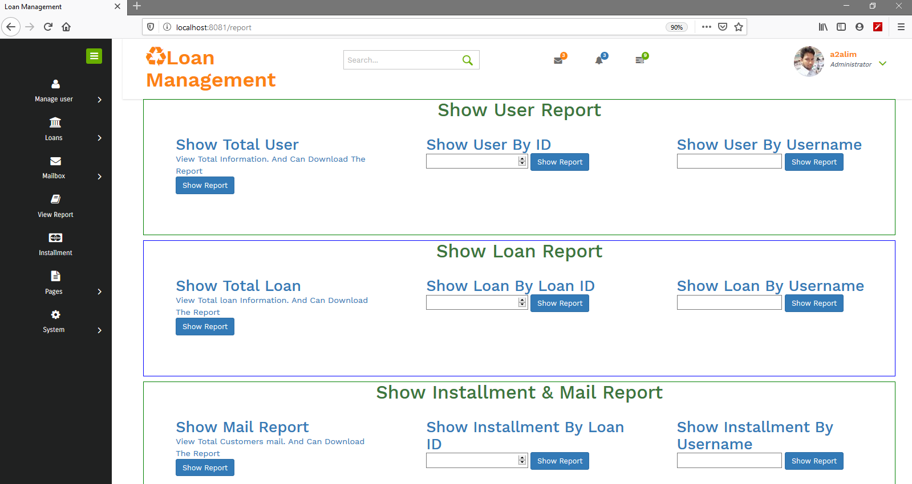
Reports can be accessed by different criteria such as >Total User report >Specific User searched by ID >Individual User searched by Username >All types of Loans >Received mail Reports >Distinct Loan searched by Loan ID > Installments searched by Loan ID

Slide 18
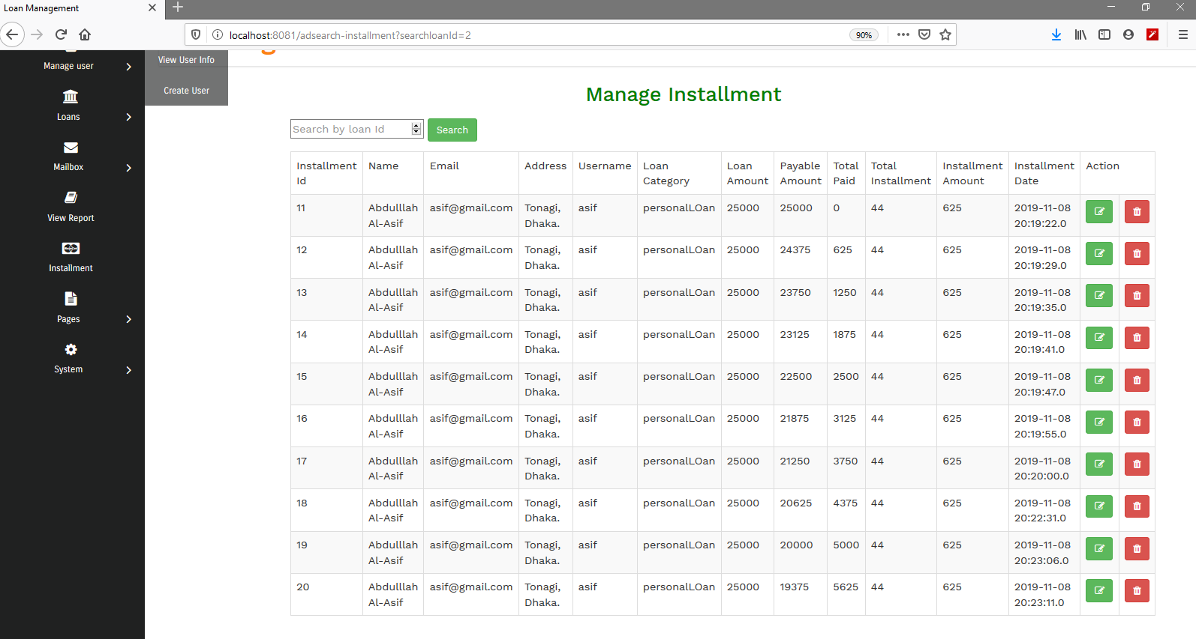
Manage Installment searching by ID
Show every installment details
Update and delete can be proceed if needed

Slide 19
THANKS FOR SPENDING YOUR VALUABLE TIME .

